Slide 1


Password Generator
01

Slide 2
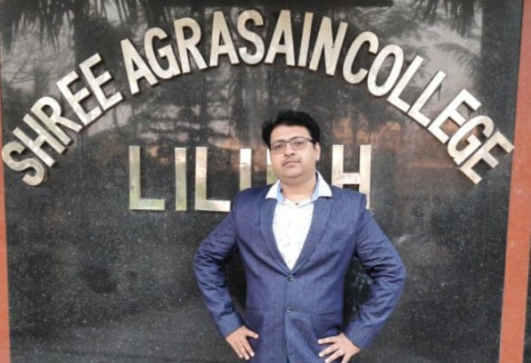
OUR Guide
Prof. Kumarjit Mondal
MCA, MBA, MMD (Master in Multimedia Dev.), Assistant Professor & HOD of Computer Science Department in Shree Agrasain College
02

Slide 3


OUR TEAM
Himangshu Rana
Soumita Bhattachyra
03

Slide 4

Introduction
Overview:
Purpose of the project
Importance of strong passwords
Brief mention of how the password generator works
04

Slide 5

Problem Statement
The Need for Strong Passwords:
Increasing cyber threats
Common password vulnerabilities
Statistics on password breaches
05

Slide 6

Project Goals:
Generate strong, random passwords
Ensure passwords meet security standards
Provide user-friendly interface
Objectives :
06

Slide 7


Methodology:
Development Approach:
HTML
CSS
JAVA SCRIPT
07

Slide 8
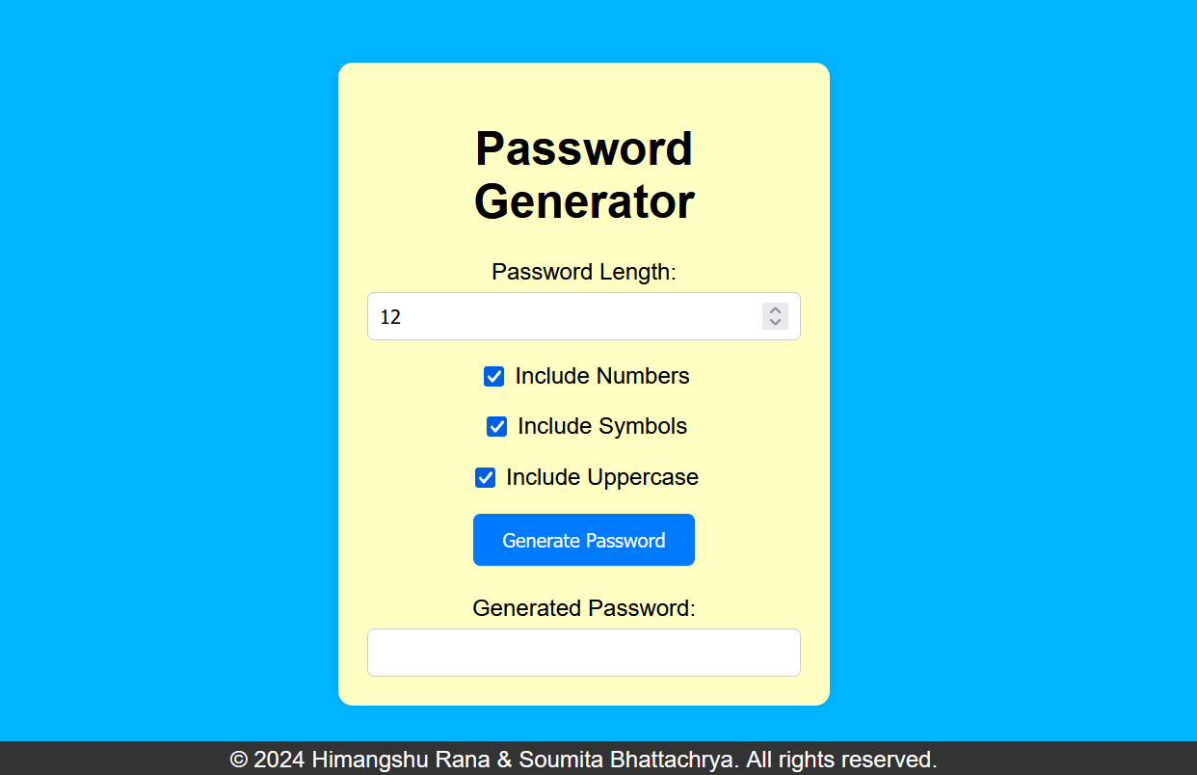
User Interface
08

Slide 9


Features :
Key Features:
Length customization
Inclusion of special characters, numbers, and letters
09

Slide 10

Security Consideration:
Ensuring Security:
Randomness and entropy
Avoiding predictable patterns
10

Slide 11

Future Work :
Potential Improvements:
Additional features (e.g., password strength meter)
Multi-language support
Mobile app version
Clipboard copy functionality
11

Slide 12

Conclusion:
Summary:
A password generator is a tool that creates strong, random passwords to enhance security. It ensures passwords are complex and unique, reducing the risk of unauthorized access to accounts
12

Slide 13
THANK YOU
13

